Slide 1
Design Patterns - GoF

Slide 2

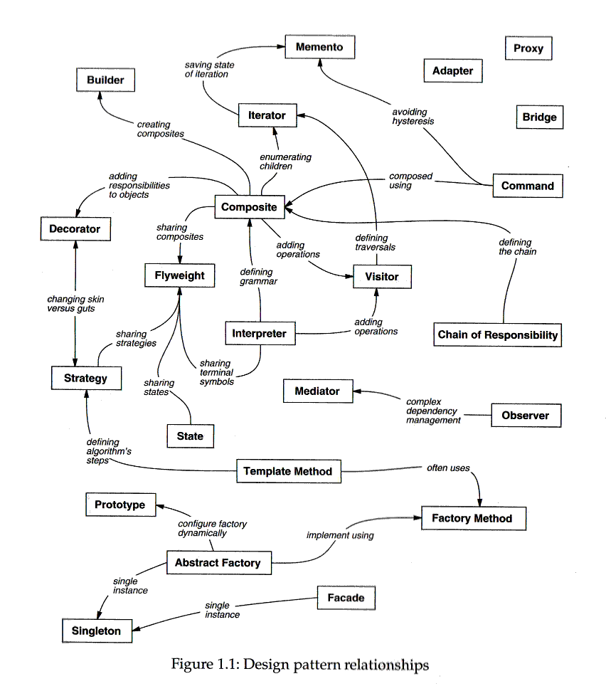

Slide 3
Day 1: Preface

Slide 4
Symbol、 Phonetic & Semantics
Symbol – how
UML diagram – Class Diagram
Coding characteristics
Phonetic – what
Why did GoF use this term as its name?
Terminology
Semantics – when/where
User scenario – what problem does it solve
Application/Implementation illustration

Slide 5
Model-View-Controller as example
Model-View : Observer pattern
Ajax-like concept
Complex View : Composite pattern
View-Controller : Strategy pattern
Controllers’ creation : Factory pattern
View’ rendering : Decorate pattern
…

Slide 6
Interface vs. Abstract class
Abstract class is a pure virtual function class in C++, in order to have an operate method.
In C++, there are three kind of inheritance.
‘public’, ‘protected’, & ‘private’
‘public’ inheritance means subtype “is a” kind of supertype.
‘private’ inheritance means subtype “has a “ supertype.
In Java, inheritance is replaced with ‘extends’ & ‘implements’
Use ’extends’ to inherit from supertype
Use ‘implements’ to inherit from ‘interface’
Replace ‘has a’ with composition

Slide 7
Polymorphism
Let ‘Horse’ to be a supertype, and ‘white horse’, ‘gray horse’, ‘elder horse’ as its subtypes.
Whether which kind of subtypes are created, we can assign it to ‘Horse’.
So that we can operate ‘Horse’ instead of knowing the real subtype
The benefit is that we can use ‘Horse’ in the following process w/o changing any code.
It’s also means no unit-test should be created in the original process.
Factory pattern is based on this specification

Slide 8
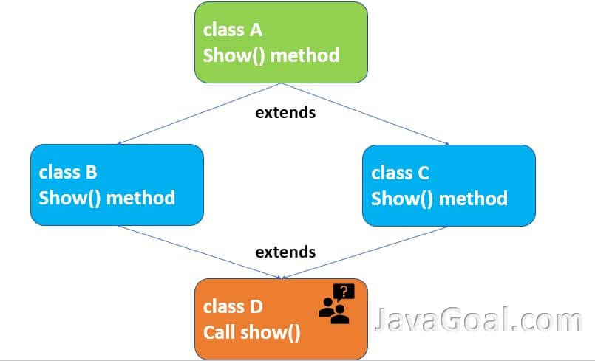
Multiple Inheritance
Diamond inheritance
Multiple class inheritance would cause ambiguous situation, but multiple interface inheritance is allowance
Why/when do we need multiple inheritance?

Slide 9
SOLID - Robert C. Martin
SRP - Single-responsibility principle
There should never be more than one reason for a class to change.
OCP - Open–closed principle
Software entities (classes, modules, functions, etc.) should be open for extension, but closed for modification.
LSP - Liskov substitution principle
Functions that use pointers or references to base classes must be able to use objects of derived classes without knowing it.
ISP - Interface segregation principle
Many client-specific interfaces are better than one general-purpose interface.
DIP - Dependency inversion principle
Depend upon abstractions, not concretions.

Slide 10
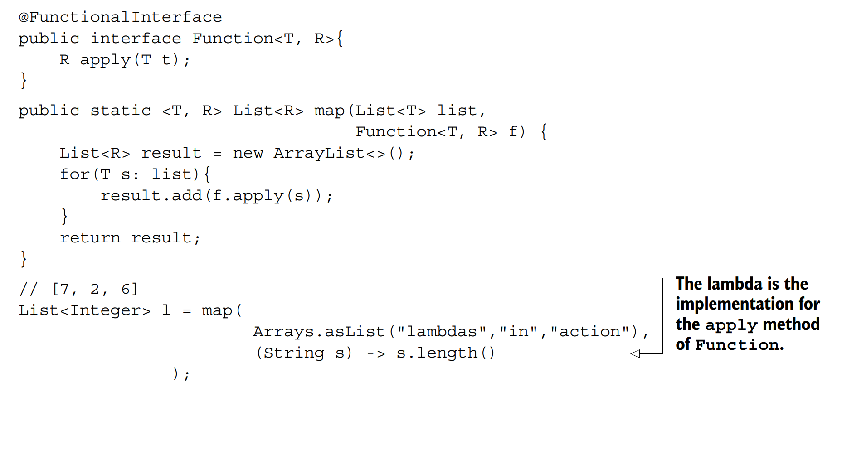
Single-responsibility principle

Slide 11
Open–closed principle
Polymorphism
Abstract interface
Dependency Invertion pattern, DIP
Decorator Patterns
Strategy Patterns
Interface Backward Compatible, i.e. table schema

Slide 12
Liskov substitution principle
Class Rectangle {
int width;
int length;
int setWidth(int w) {
width = w;
}
….
}
Classs Square extends Rectangle {
int setWidth(int w) {
width = w; length = w;
}
int setLength(int l) {
length = l; width = l;
}
}
Class RectangleAreaCalculator {
int getArea(Rectangle r) {
return r.width * r.length;
}
}
Unittest:
Rectangle r = new Square();
r.setWidth = 5;
r.setLength = 4;
RecTangleAreaCalculator calc = new RecTangleAreaCalculator();
AssertEqual(calc.getArea( r ), 20)

Slide 13
Interface segregation principle
interface IMultiFunction {
public void print();
public void scan();
public void fax();
public void copy();
}
Class SimplePrinter implements IMultiFunction {
void print() { …. }
void scan() {
throw Exception(“no such function”);
}
void fax() {
throw Exception(“no such function”);
}
void copy() {
throw Exception(“no such function”);
}
}
interface IPrint {
public void print();
}
interface IScan {
public void scan();
}
interface IFax {
public void fax();
}
interface ICopy {
public void copy();
}
Class SuperPrinter implements IPrint, IScan, IFax, ICopy { … }

Slide 14
Dependency inversion principle
Class Car {
private V6Engine engine;
Car ();
}
Class NiceCar extends Car {
private V8Engine engine;
NiceCar();
}
Class FutureCar extends Car {
private VxEngine engine;
FutureCar();
}
Class IEngine;
Class V6Engine implements IEngine;
…
Class VxEngine implementss IEngine;
Class Car {
private IEngine engine;
Car (IEngine engine) {
this.engine = engine;
}
Class NiceCar extends Car {
NiceCar(IEngine engine) {
super(engine);
}
Car
IEngine
V6Engine
V8Engine
VxEngine

Slide 15
OO Design Principle in this book
Program to an interface, not an implementation.
Always use supertype instead of subtype.
All 5 creational patterns are for this purpose.
Favor object composition over class inheritance.
Composition
GoF claim that ‘inheritance often breaks encapsulation’
Delegation
From ‘is a ‘ to ‘has a’ and is easy to change subtype dymanically.
Java Dependency Injection : it also refer to DIP
i.e. State, Strategy, and visitor patterns
Generic or Template

Slide 16
Day 2: Creational Patterns

Slide 17
Abstract Factory

Slide 18
Builder

Slide 19
Factory Method

Slide 20
Prototype

Slide 21
Singleton

